Slide 1

FINAL PROJECT - DATA SCIENCE
Team Members in order of presentation:
Sayira Furnish
Jen Kenley
Alexis Ware

Slide 2

Initial Data & Team Interests
Original topics were disparate (Crime, Mental Health, Death Penalty) so focused on choosing one dataset that interested all team members enough to find questions each wanted to ask.
Dataset used for this project:
Hate_Crime_Incidents_per_Bias_Motivation_and_Quarter_ by_State_Federal_and_Agency_2019 dataset
Posted on Kaggle by Sumaia P. Data originally collected by FBI via their Uniform Crime Reporting Program’s Hate Crime Statistics Program:
https://www.fbi.gov/services/cjis/ucr/

Slide 3

Sayira Furnish - Final Project
Hate Crimes dataset detailed how many crimes per state, defining crimes by the motivating target (Race, Religion, Sexual Orientation, Gender, Gender ID, Disability).
As reviewed the dataset, found myself asking what would see if pulled demographic data in, opening door to these 2 questions:
How does demographic makeup of a state affect types of Hate Crimes committed?
How does demographic makeup of a state affect the # of Hate Crimes committed?
This led to the US Census site’s State Visualizations of Key Demographic Trends from the 2020 Census: https://www.census.gov/library/stories/state-by-state.html
Using data pulled from this site, a 2nd dataset was built and included in the data wrangling.

Slide 4
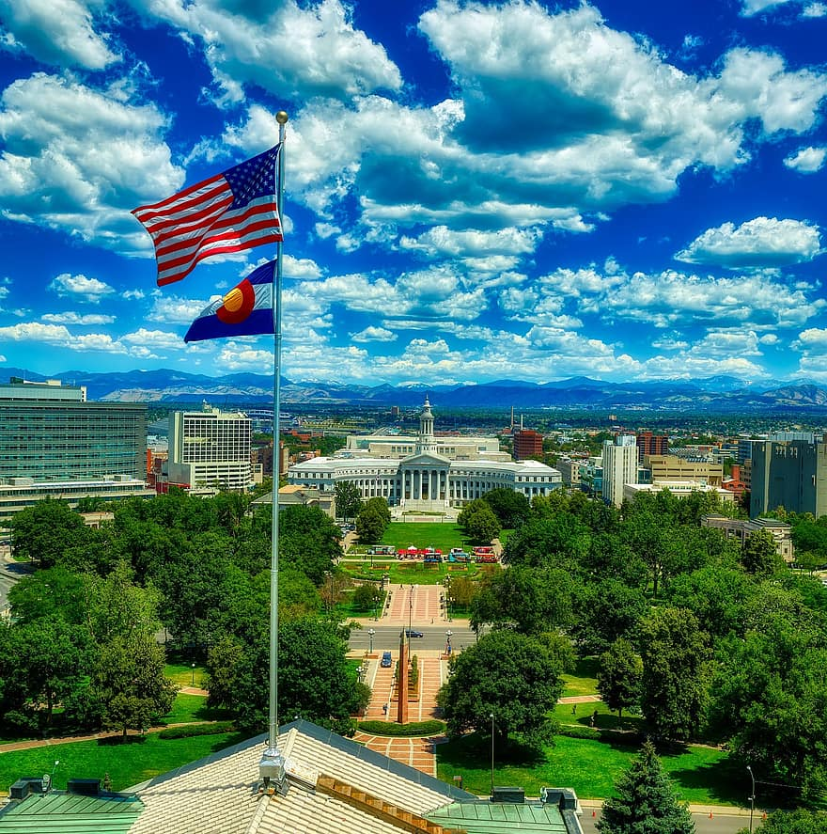
Data Wrangling (Python)
Hate Crime dataset does not include data for Alabama
When looked to collect missing data directly from source site, found there was no Alabama data reported for 2019
Alabama agencies started participating in reporting data to FBI UCRP in 2020
Did not include Alabama in build of demographics dataset
US Census site provided State, race percentages per state, and state population
Set up equations for spreadsheet to calculate population #s for each race classification based on state population and race percentages

Slide 5

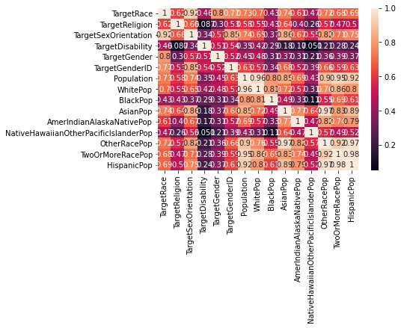
Exploratory Analysis
Correlation Matrix
(all correlations positive)
First ran without heatmap - useful because all digits are legible.
Then ran with heatmap. While the digits are not as legible, the colors help clarify the correlation spread and make it easy to pinpoint areas of interest.

Slide 6
Exploratory Analysis
Very High Correlations (90% and higher)
State Population : White Population
State Population : Hispanic Population
State Population : Two Or More Race Population
State Population : Other Race Population
Asian Population : Other Race Population
Hispanic Population : Other Race Population
Hispanic Population : Two Or More Race Population
Crimes Target Race : Crimes Target Sex Orientation

Slide 7

Exploratory Analysis
High Correlations (80% and higher)
State Population : Black Population
State Population : Asian Population
White Population : Black Population
White Population : Hispanic Population
White Population : Two Or More Races Population
Asian Population : Hispanic Population
Asian Population : Two Or More Races Population
Amer Indian Alaskan Native Pop : Other Race Population
Crimes target Race : Crimes target Gender
Crimes target Sex Orientation : Crimes target Gender ID
Crimes target Sex Orientation : Asian Population
Crimes target Sex Orientation : Other Race Population

Slide 8

Exploratory Analysis
Very Low / Low Correlations (20% and lower)
Crimes target Religion : Crimes target Disability
Crimes target Disability : Asian Population
Crimes target Disability : Native Hawaiian Other Pac Islander
Crimes target Disability : Amer Indian Alaskan Native Pop
Crimes target Sex Orientation : Other Race Population
Native Hawaiian Other Pac Islander : Black Population

Slide 9
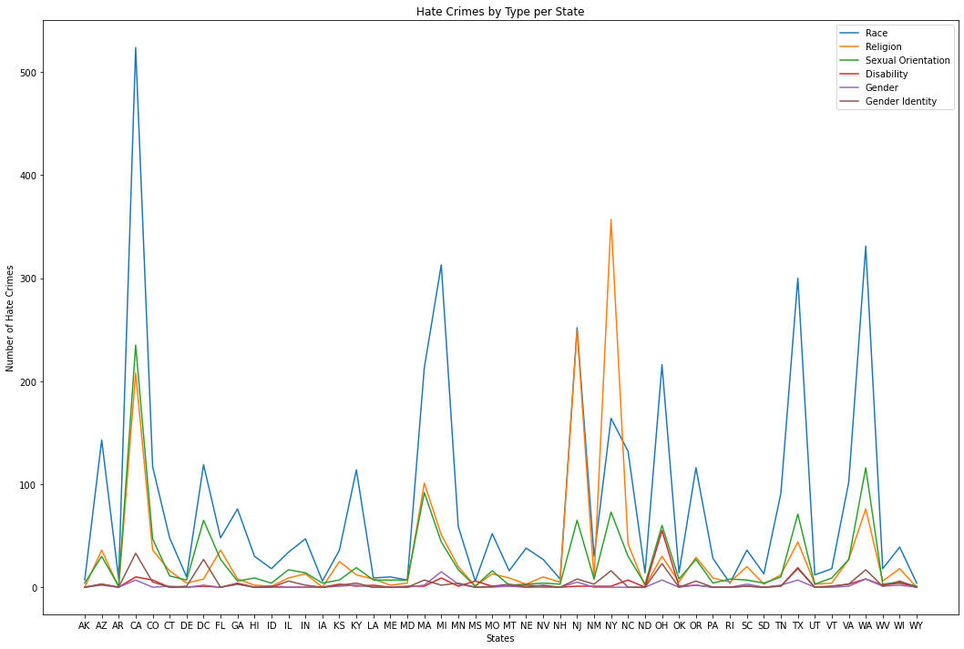
Amount of Hate Crimes by Type per State
Gives impression most crimes generally occur in CA, MA, MI, NJ, NY, OH, TX, WA.
However, this does not control for variation between state populations.

Slide 10
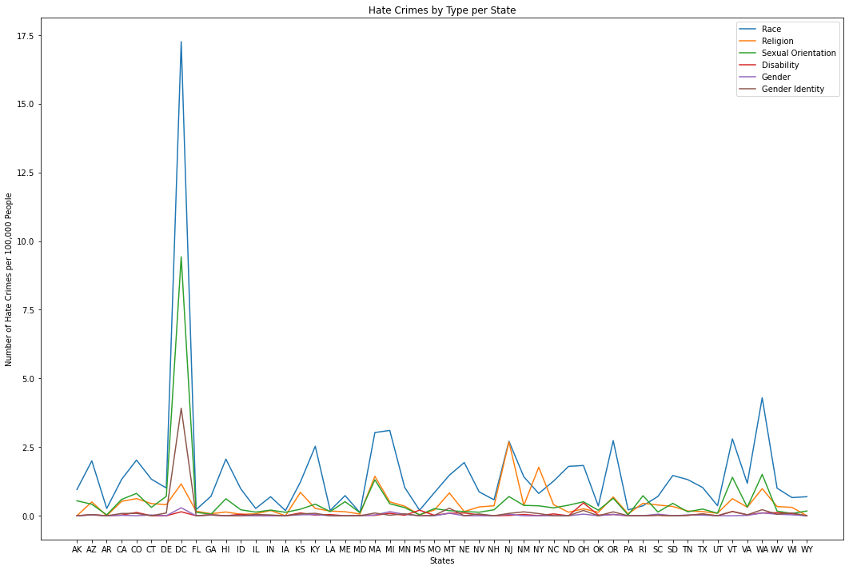
Amount of Hate Crimes by Type per State per 100K
Controlled for variation between state populations.
This results in much more similarity across the board except for DC.

Slide 11
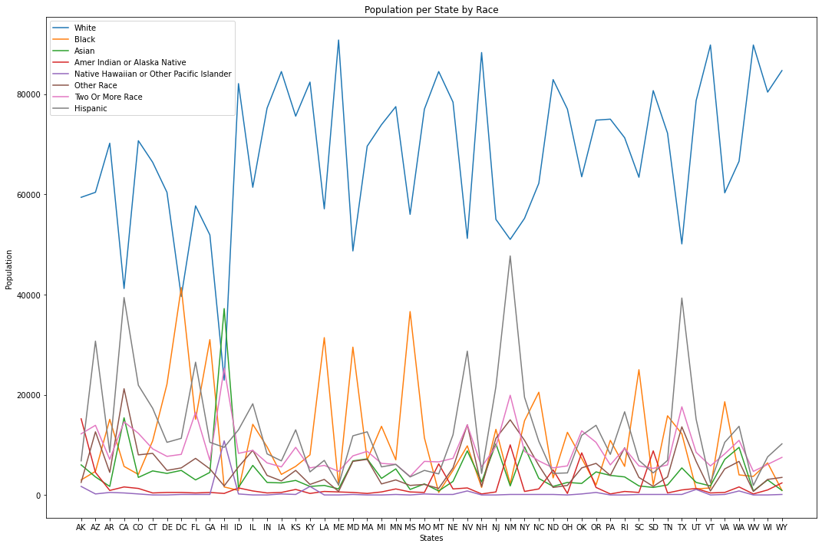
Suggests demographic differences don’t mean much in regards to # and type of hate crimes within a state.
Visualization of race breakdown per state. Controlled for variation between state populations.

Slide 12

Data Analysis
How does demographic makeup of a state affect the # of Hate Crimes committed?
How does demographic makeup of a state affect types of Hate Crimes committed?
Realized this question format does not clarify how demographic makeup is being measured using the 8 categories of Race Population
Used Simpson’s Diversity Index [1 - D] to clarify
Measures probability that 2 randomly selected individuals belong to different species
D = Σ(n_{i} * (n_{i} - 1)) / (N * (N - 1)) where
N = total # of individuals in community
n_{i} = # of individuals in the i-th species
The higher the number, the more diverse the group

Slide 13

Data Analysis
Question Setup
Is there a difference in # of hate crimes among states with different Diversity Indices?
IV is DI
Continuous
DV is Total # of Crimes (controlling for population)
Continuous
Appropriate Analysis = Simple Linear Regression

Slide 14
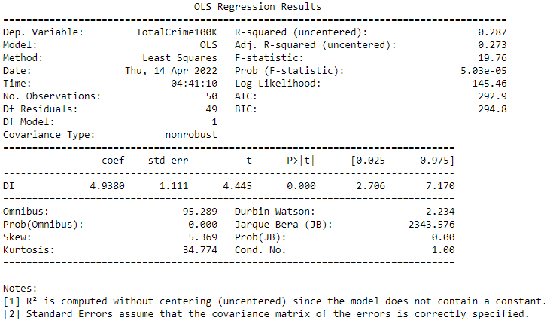
p < 0.05
There is statistically significant association between DI and Total Crime.
R-squared is 0.287. Only 28% of variation in Total Crime can be explained
by DI.

Slide 15
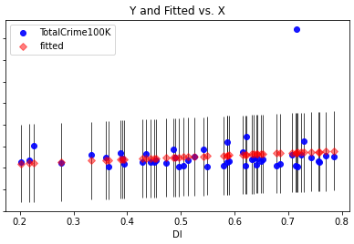
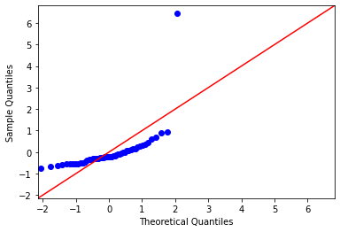
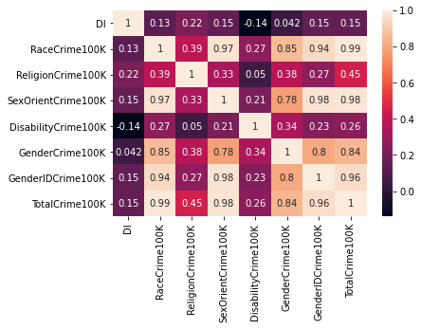
In regression plots, appears to be slight positive correlation.
Suggests that as DI rises, Total Hate Crimes rise as well.
In correlation matrix, low correlation between DI and Total Hate Crimes; also between DI and any type of crime. Negative correlation with Disability Crime.

Slide 16

Summary
Data Wrangling is a fun, iterative process
DC has an inordinate amount of crime for its population
Correlation Matrices are a great way to visualize data relationships and get ideas for questions to ask
The interplay between Crime and Diversity is a complex topic
Google is a great friend to those in data analytics and data science

